Slide 1
Introduction

Slide 2
Special thanks to..
Gold sponsors
Location
Partners

Slide 3
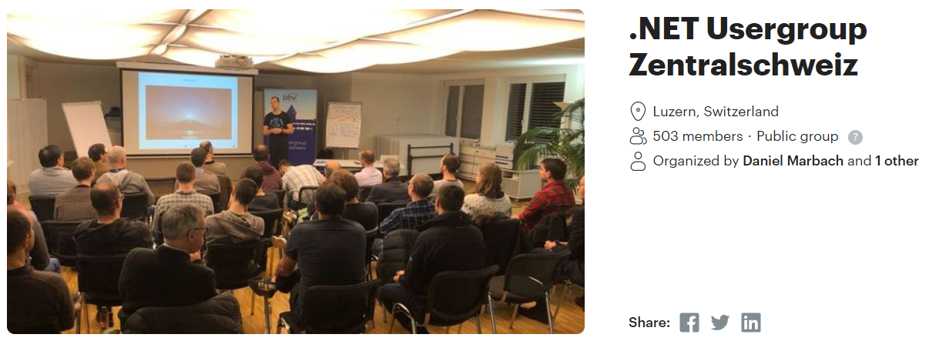
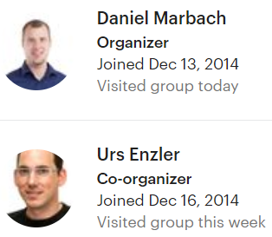
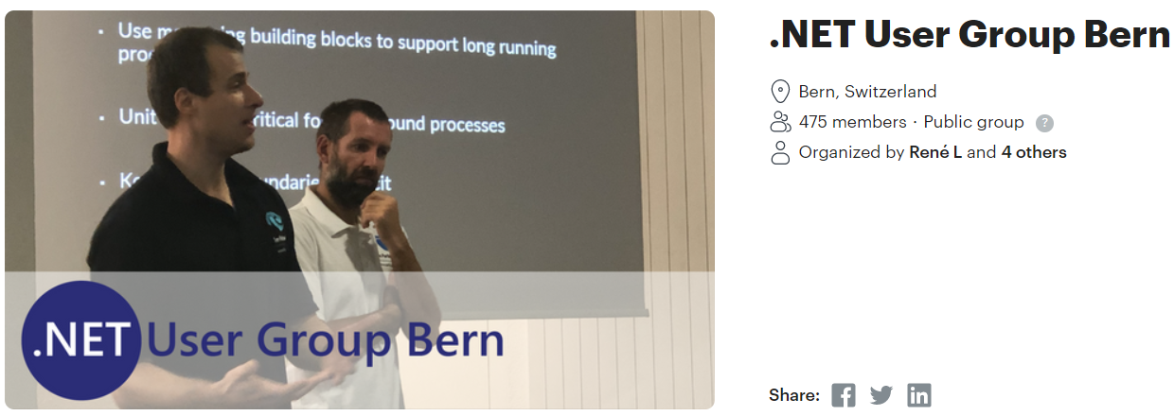
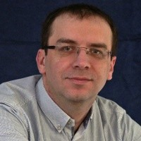
In collaboration with..
&
René Leupold
Organizer

Slide 4
.NET User Group Zürich
From Developers, For Developers
Share knowledge
Create excitement about technology
Networking included
Beer & Pizza! (Today we will try some online networking :) )

Slide 5
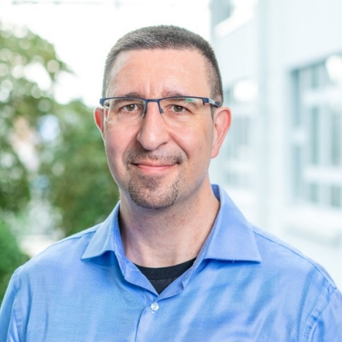
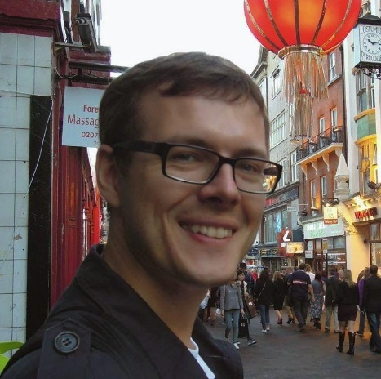
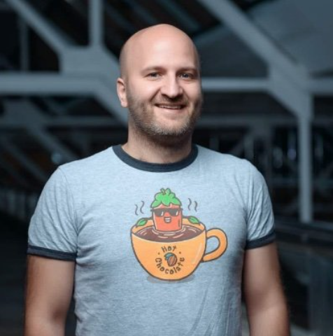
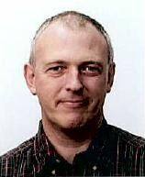
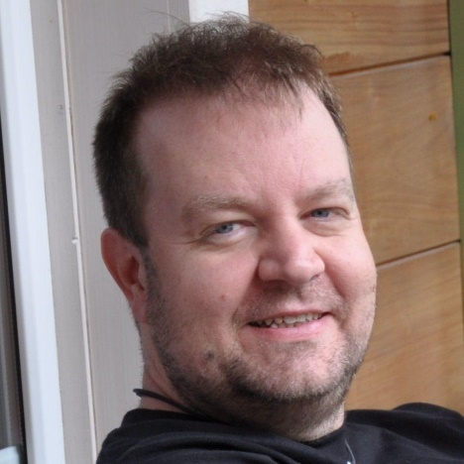
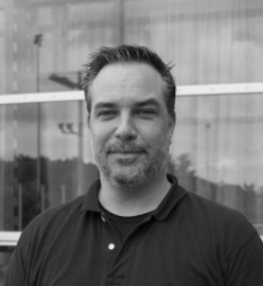
Who?
@joslat
@pniewolny
@michael_staib
@NigelFindlater
@lbugnion
@FabianGosebrink
@MuellerMarc

Slide 6
What?
Do events regularly.
Quality talks, speakers & content.
Networking & Beer.
Learning while sharing good moments.
Try to stream and publish events online!

Slide 7
What can I do?
Follow us on Twitter @dotnetzurich
Join our meetup group.
Tell your peers, help us grow.
Propose content & speakers.
www.dotnet-zurich.ch
#dotnetzurich
Notes:
Guess you did already so…

Slide 8
Today!
Join through Zoom or youtube
Got a question? Post it on Sli.do (we will respond to questions at the end of the talk)
Please subscribe to our youtube channel – we need subscribers! :)
Any “Zoom Bombing” will be removed

Slide 9
We want you! :)

Slide 10
Special thanks to..
Gold sponsors
Location
Partners

